Slide 1

AGRICULTURAL FIELD MONITORING SYSTEM
INDIAN INSTITUTE OF TECHNOLOGY, KANPUR
ARTIFICIAL INTELLIGENCE AND INTERNET OF THINGS

Slide 2
INTRODUCTION
Modernization of the farming process is one of the crucial steps for a country like India.
Various technological improvements have been suggested in the past and have been adopted over years to improve the productivity of the agriculture field.

Slide 3
INTRODUCTION
One of the major challenges in agriculture is the proper monitoring of the soil health, the environment , and adjusting the irrigation according to this observation.
Traditionally, Indian farmers have adopted manual observation based technique which has resulted in either excessive use of pesticides or under use of watering which results in less efiicient and less productive crops.

Slide 4
INTRODUCTION
One of the major challenges in agriculture is the proper monitoring of the soil health, the environment , and adjusting the irrigation according to this observation.
Traditionally, Indian farmers have adopted manual observation based technique which has resulted in either excessive use of pesticides or under use of watering which results in less efiicient and less productive crops.

Slide 5
ABOUT THE PROJECT
Devoloping an agriculture field monitoring system comprising of multiple sensors _light sensor, moisture sensor , temperature sensor ,and network of nodes in mesh topology.
The monitoring data should be sent to cloud server.

Slide 6
HARDWARE REQUIREMENTS
NodeMCU : for working as a node in the mesh network, some nodes will work as sensor clients, one node will work as a central node(for collecting data from all the sensor clients) and one will work as a gateway to send the data to the cloud.
Sensors : sensors such as, Temperature sensor, Moisture sensor can be used for sensing field data.
Software: Arduino IDE

Slide 7
BASIC IDEA
CREATING MESH NETWORK
SENDING DATA THROUGH MESH NETWORK TO A CENTRAL NODE
SENDING DATA FROM CENTRAL NODE TO CLOUD

Slide 8
MESH NETWORK
A mesh network is a network in which the devices or nodes are connected so that at least some , and sometimes all, have multiple paths to other nodes.
This creates multiple routes for information between pairs of users, increasing the resilience of the network in case of a failure of a node or connection.

Slide 9
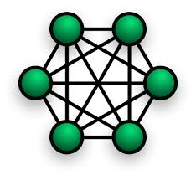
Mesh network

Slide 10
How we tried to create mesh network:
Making clients as station points for sending sensor data.
Making intermediate nodes as station and access point
Making central node as access point
Transferring data from central node to ThingSpeak.

Slide 11
Problem faced:
All node are connected as per the idea, but…
Sensor Data was not transferring from clients to other nodes.
So , we tried couple of ways for creating mesh network…

Slide 12
PAINLESS MESH:
painlessMesh is a library that takes care of the particulars of creating a simple mesh network using esp8266 hardware. The goal is to allow the programmer to work with a mesh network without having to worry about how the network is structured or managed.

Slide 13
Another major Task:
Sending data from our mesh network to ThingSpeak:
1.using central node as bridge(MQTT bridge)
2.using gateway(serial communication)

Slide 14
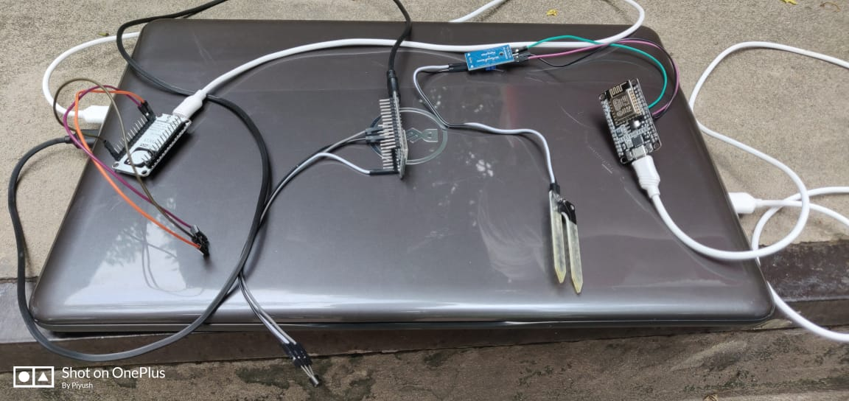
Snapshots:
Sensors are connected to three node

Slide 15
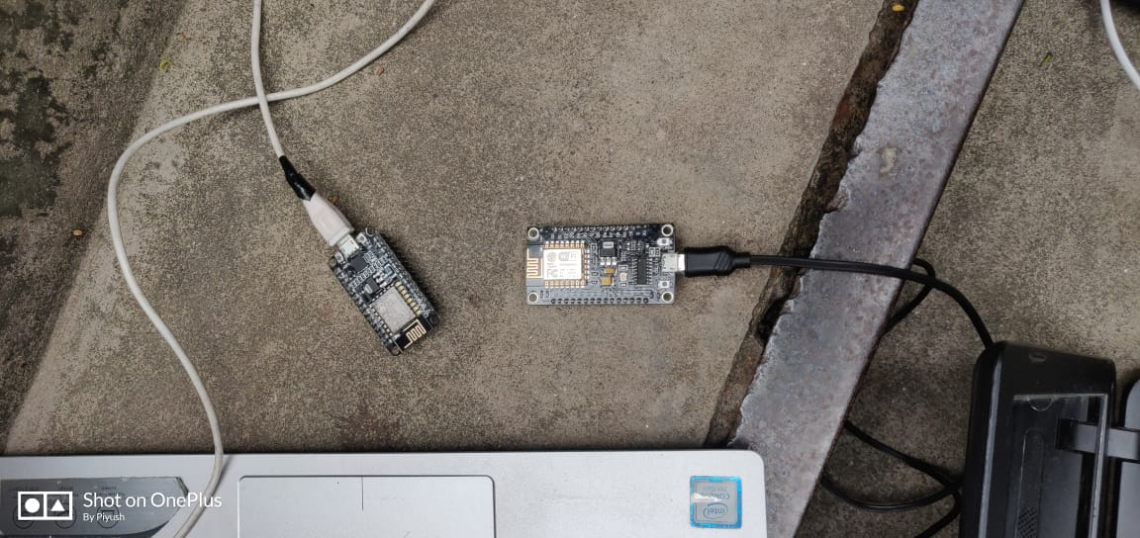
Intermediate nodes

Slide 16
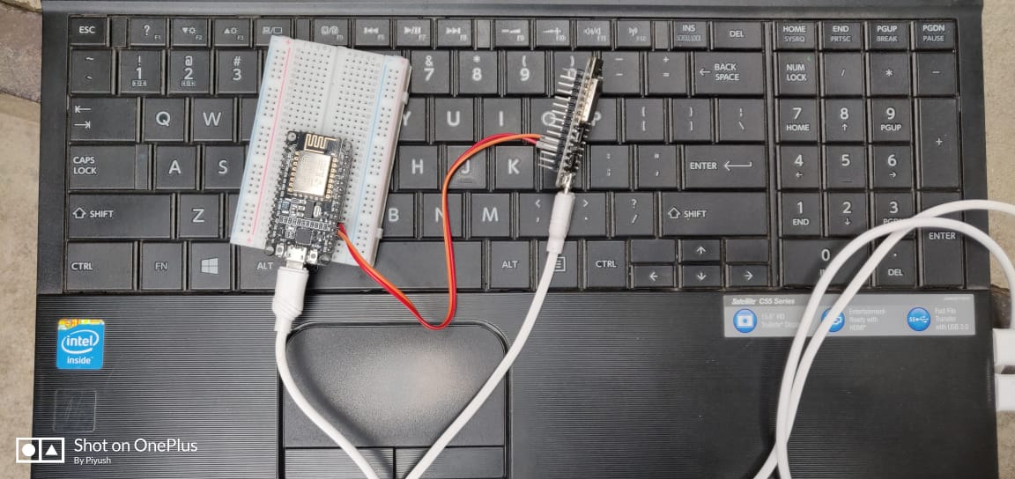
Central Node and Gateway

Slide 17
CONCLUSIONS
Based on the mentioned project setup different level of soil moisture and temperature value can be sensed.
In the absence of human being in the agriculture field, this system provides continuous field monitoring.

Slide 18
FUTURE WORK
Instead of using a separate node for sending data to ThingSpeak cloud we can use a single central node which collects data from sensor clients and sends it to the cloud.
Controlling high voltage farming equipments on the basis of predefined threshold value of soil moisture and temperature without human intervention.
Connecting multiple mesh networks together to cover a large area of field for data sensing.

Slide 19
THANK YOU

